Slide 1


Here's your outline to get started
Key facts about your topic
In business, master data management is a method used to define and manage the critical data of an organization to provide, with data integration, a single point of reference. The data that is mastered may include reference data- the set of permissible values, and the analytical data that supports decision making.
See more: Open the Notes below for more information.
Notes:
QuickStarter has created an outline to help you get started on your presentation. Some slides include information here in the notes to provide additional topics for you to research.

Slide 2
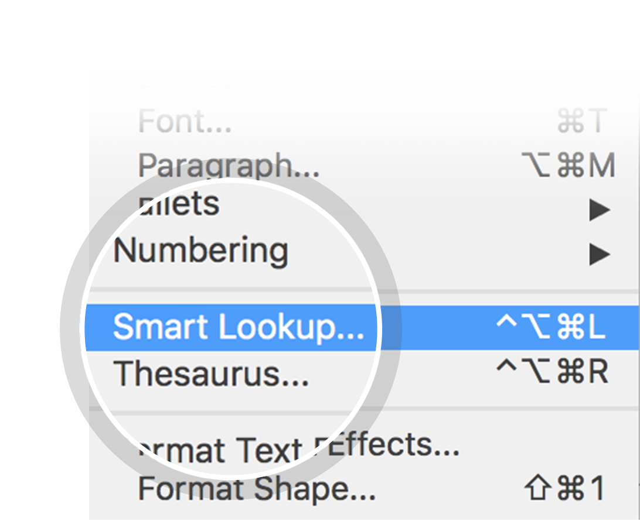
Related topics to research
Master data
Data governance
Data integration
Reference data
Data steward
Data warehouse
Data management
Business intelligence
Operational data store
Microsoft SQL Server Master Data Services
Use Smart Lookup to learn more
1
Highlight one of the related topics
Right-click on the topic
Choose "Smart Lookup"
2
3

Slide 3
Master data management

Slide 4
Contents
Goal
Issues
Products
Transmission of master data

Slide 5
Goal

Slide 6
Issues

Slide 7
Products

Slide 8
Transmission of master data

Slide 9
Works cited

Slide 10
Notes/Ideas
Visualizing C2 (Raytheon) https://breakingdefense.com/2018/07/exclusive-what-multi-domain-c2-may-look-like-raytheons-rick-yuse/
MDC2 Education and training must teach each member how their tactical job or function fits into the broad multi-domain effort. The focus must be on achieving the operational objective. This makes individuals ready to support units that operate in other domains.

